Slide 1
It’s 2015! Are You Ready for ACA Reporting??
Presentation to MLGHRA
June 16, 2015
Maine Municipal Employees Health Trust
1-800-852-8300
www.mmeht.org
The Difference Is Trust

Slide 2
Today’s Agenda
The Individual Mandate
Reporting Requirements
The Cadillac Tax

Slide 3
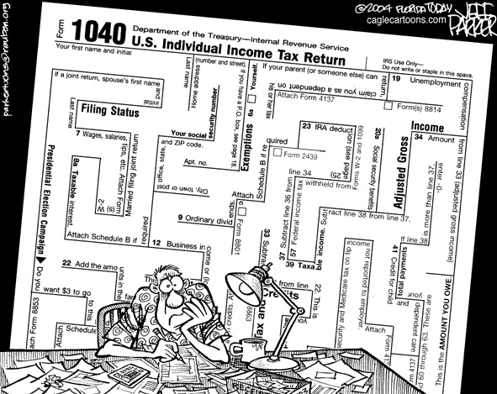
The Individual Mandate and the 2014 Tax Return

Slide 4
The Individual Mandate
Also referred to as Individual Shared Responsibility
Starting in 2014, with a few exceptions, individuals are required to have health insurance
Insurance may be through: an employer, Medicare, Medicaid, CHIP, veterans health or Tricare, grandfathered health plan, or individual coverage (through the Exchange or otherwise)
Coverage must meet certain level of benefits –
Minimum Essential Coverage
60% actuarial value - Bronze plan

Slide 5
What is Minimum Essential Coverage?
Minimum essential coverage includes:
Health care coverage provided by your employer
Health insurance coverage you buy through the Health Insurance Marketplace
Many types of government-sponsored health coverage including Medicare, most Medicaid coverage, and most health care coverage provided to veterans and active duty service members
Certain types of coverage you buy directly from an insurance company

Slide 6
When to Report and When to Pay
Individuals must report when filing taxes (form 1040) starting in 2015 (for 2014 tax year)
Penalty will be assessed for not having insurance
Penalty will be pro-rated by the number of months without coverage
No penalty for a single gap in coverage of less than 3 months in a year (exemption)
Maximum penalty tied to the national average premium for the lowest cost bronze-level plan available in the health insurance marketplace

Slide 7
Reporting on Form 1040 – Line 61 *
* Health Care Individual Responsibility = Individual Mandate.
* Also found on Form 1040EZ (line 11) and Form 1040A (line 38).

Slide 8
Line 61 - Instructions
Note: Your Individual Responsibility includes anyone you could or did claim as a dependent.
If you and your dependents had coverage for all 12 months, just check the box. No further documentation required.

Slide 9
Who May Claim an Exemption?
Exemptions may be available if:
Gross family income is below threshold for filing income tax
For 2014, threshold is $10,150 for single person under age 65
Coverage is unaffordable
Required contribution for coverage is more than 8% of household income
Based on lowest cost option available through employer (if available), or
Lowest cost bronze plan available through the Marketplace, less maximum premium tax credit available for purchasing that plan
Member of a health care sharing ministry
Member of a federally-recognized Indian tribe

Slide 10
The “Short Coverage Gap” Exemption
Exemptions may be also available if there is a “Short Coverage Gap”
One gap in coverage per year
Gap must be less than three consecutive months
If gap is three months or more – no exemption
If more than one short gap in a year – exemption only for the first gap
Individual is treated as having coverage for any month in which he has coverage for at least one day
Suppose someone is without coverage from April 5 to July 25?
Sometimes three months looks more like four

Slide 11
Form 8965 – Coverage Exemptions

Slide 12
Coverage Exemptions - Codes

Slide 13
No Coverage and No Exemptions
What is the annual penalty for not having coverage?
2014: Greater of $95 per adult and $47.50 per child (up to $285 per family), or 1% of family income *
Maximum (based on 1% of income) - $2,448 for individual, up to $12,240 for family of 5
2015: Greater of $325 per adult and $162.50 per child (up to $975 per family), or 2% of family income *
2016: Greater of $695 per adult and $347.50 per child (up to $2,085 per family), or 2.5% of family income *
After 2016 – will be indexed, based on Cost of Living
Penalty will be pro-rated if covered for part of the year
* “Income” = Total household income in excess of the applicable filing threshold (i.e., the threshold for having to file an annual tax return). For 2014, the filing threshold is $10,150 for a single person under age 65 with no dependents, and $20,300 for a married couple filing jointly. Neither the filing thresholds nor the penalty caps have been determined yet for 2015 and 2016.

Slide 14
Individual Tax Returns - Resources
2014 Form 1040 and Instructions:
http://www.irs.gov/pub/irs-pdf/f1040.pdf
http://www.irs.gov/pub/irs-pdf/i1040gi.pdf
Form 8965 (Health Coverage Exemptions) and Instructions:
http://www.irs.gov/pub/irs-pdf/f8965.pdf
http://www.irs.gov/pub/irs-pdf/i8965.pdf

Slide 15
Coming Soon –
Reporting Requirements
For Insurers and Large Employers

Slide 16
Insurer / Plan Sponsor Reporting on Minimum Essential Coverage
Section 6055 of the Internal Revenue Code
Responsibility of insurer or plan sponsor
Responsibility of health insurance carrier for fully-insured plans
Plan sponsor responsible for reporting if self-insured
MMEHT is self-insured plan
Health Trust is plan sponsor for MMEHT plan
Provides individuals and IRS with information re: Minimum Essential Coverage (MEC)
Lets individuals know whether they satisfied the individual mandate for preceding calendar year
Section 6055 reporting is Health Trust responsibility

Slide 17
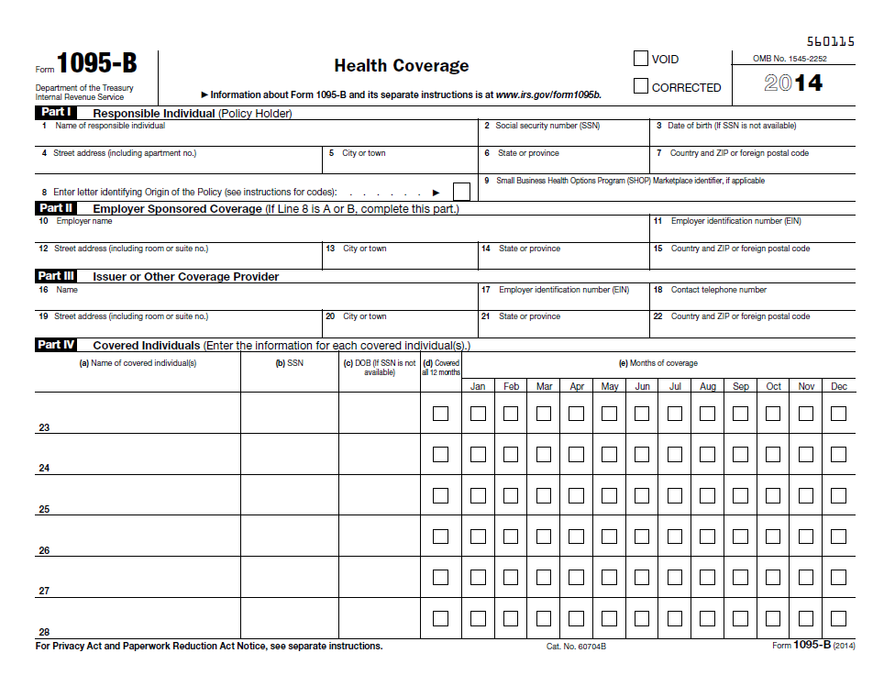
Form 1095-B Instructions
Form 1095-B (Insurer / Plan Sponsor)

Slide 18
MEC Reporting - Form 1095-B
Part I:
Reporting includes:
Name, address, and SSN for Policy Holder (employee)
Use DOB if SSN not available
SSN may be truncated (5 asterisks, last 4 numbers)
May not truncate SSN on forms filed with IRS
Separate Form 1095-B provided to each Policy Holder

Slide 19
MEC Reporting - Form 1095-B
Part II:
Reporting includes:
Name, address, and EIN of Employer
Part III:
Reporting includes:
Name, address, phone number, and EIN of Insurer or other Coverage Provider
EIN may be truncated (5 asterisks, last 4 numbers)
May not truncate EIN on forms filed with IRS
Separate Form 1095-B provided to each Policy Holder

Slide 20
MEC Reporting - Form 1095-B
Part IV:
Reporting includes:
Who was enrolled and when (by month)
Identifying info (name and SSN or TIN) for each covered individual – employee and dependents
Use DOB if SSN not available
Separate Form 1095-B provided to each Policy Holder
Form 1094-B (Transmittal) sent to IRS with all completed Forms 1095-B

Slide 21
Form 1094-B (Transmittal to IRS)

Slide 22
Form 1094-B
Transmittal to IRS
Includes:
Name, address, contact name and telephone number, and EIN for Insurer / Plan Sponsor
Total number of Forms 1095-B submitted with transmittal
Form 1094-B (Transmittal) sent to IRS with all completed Forms 1095-B

Slide 23
Forms 1094-B and 1095-B Instructions
4 pages of instructions
Every provider of MEC must provide an information return (1095-B) to each policyholder. Copies of the Forms 1095-B must be submitted with a transmittal form (1094-B) to the IRS.
Plan sponsors are responsible for reporting self-insured coverage.

Slide 24
MEC Reporting
Mandatory reporting begins in 2016 for 2015 plan year
Voluntary reporting for 2014 plan year
Health Trust did not report for 2014
Statements must be provided to covered individuals by January 31 of the following year
1/31/2016 for 2015 plan year
Statements must be furnished on paper by mail, unless affirmative consent by recipient to receive in electronic format
Electronic returns must be provided to the IRS by March 31 of the following year
3/31/2016 for 2015 plan year
2/28/2016 for 2015 plan year, if paper filing

Slide 25
MEC Reporting
MEC reporting to be done on Form 1095-B (to Policy Holders) and 1094-B (Transmittal to IRS, with copies of all Forms 1095-B)
Final 2014 forms and instructions may be viewed on IRS website at:
http://www.irs.gov/pub/irs-pdf/f1095b.pdf
http://www.irs.gov/pub/irs-pdf/f1094b.pdf
http://www.irs.gov/pub/irs-pdf/i109495b.pdf
There may be changes for 2015 …… more to come.

Slide 26
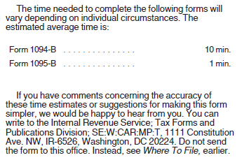
IRS Estimates – Just for Fun
From the IRS Instructions for Forms 1094-B and 1095-B:

Slide 27
Large Employer Reporting on Coverage / Affordability

Slide 28
Large Employer Reporting on Coverage / Affordability
Section 6056 of the Internal Revenue Code
Employer Responsibility/Individual Subsidy Eligibility
Employer responsibility
Applicable Large Employers
50+ full-time/full-time equivalent employees
Provides individuals and IRS with information regarding:
Months during which each full-time employee was covered
Affordability of health plans offered
Information will be used to determine:
Whether individual is eligible for a subsidy through the health insurance marketplace
Whether large employer is subject to penalty under Employer Shared Responsibility provision of the ACA
Section 6056 reporting is employer responsibility

Slide 29
Form 1095-C (Large Employer)

Slide 30
Employer Reporting – Form 1095-C
Part I:
Reporting includes:
Employee’s name, address, and SSN
SSN may be truncated (5 asterisks, last 4 numbers)
May not truncate SSN on forms filed with IRS
Employer’s name, address, phone number and EIN
May not truncate EIN on forms filed with IRS
Separate Form 1095-C provided to each Full-Time Employee

Slide 31
Employer Reporting – Form 1095-C
Part II:
Reporting includes:
Month-by-month information regarding:
Offer of Coverage
See slide 33 - Code Series 1 for Line 14
Employee Contribution
Only if entered Code 1B, 1C, 1D, or 1E in Line 14
Safe Harbor
See slide 34 - Code Series 2 for Line 16

Slide 32
Employer Reporting – Form 1095-C
Part III:
For self-insured large employers only
Reporting includes:
Who was enrolled and when (by month)
Identifying info (name and SSN or TIN) for each covered individual – employee and dependents
Part III does not need to be completed by MMEHT member groups

Slide 33
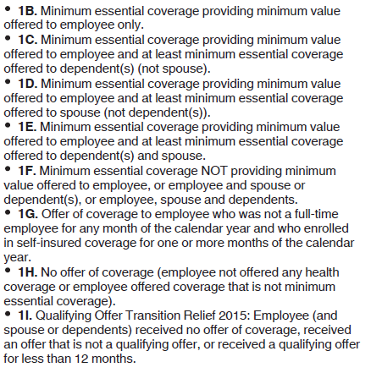
Form 1095-C, Line 14 - Codes
ALEs will need to complete this information for each full—time employee (30+ hours/week).

Slide 34
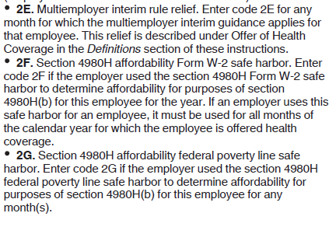
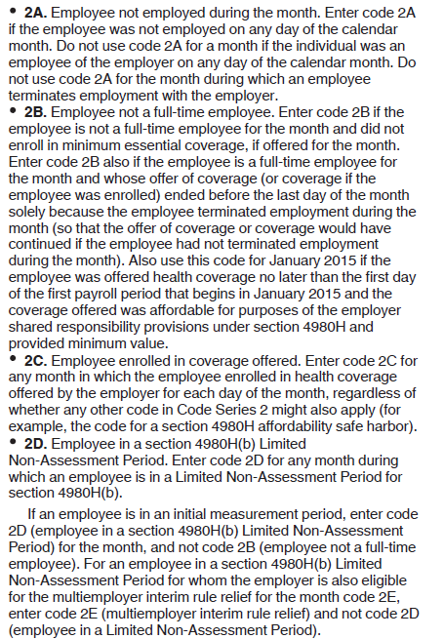
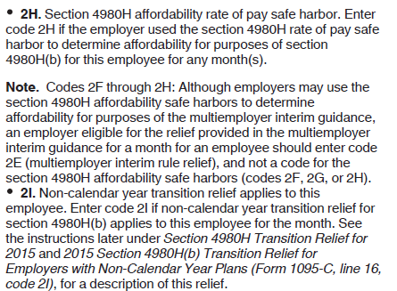
Form 1095-C, Line 16 - Codes

Slide 36
Form 1094-C (Transmittal to IRS) – p.1

Slide 37
Employer Reporting – Form 1094-C
Part I:
Reporting includes:
Name, address, contact name and telephone number, and EIN for Applicable Large Employer (ALE)
Information regarding Designated Governmental Entity filing on behalf of the ALE (only if applicable)
Total number of Forms 1095-C submitted with transmittal
Form 1094-C (Transmittal) sent to IRS with all completed Forms 1095-C

Slide 38
Employer Reporting – Form 1094-C
Part II:
Reporting includes:
ALE Member Information
Name, address, contact person, etc.
Total number of Forms 1095-C filed
Part of Aggregated ALE Group?
If “no” – do not complete Part IV
Certifications of Eligibility

Slide 39
Employer Reporting – Form 1094-C
What are Certifications of Eligibility? – Part 1
Qualifying Offer Method
Qualifying Offer = minimum value, affordable, minimum essential coverage to employee + minimum essential coverage to spouses and dependents
Employer made Qualifying Offer to at least one full-time employee for all months, and reports this on Form 1095-C, Line 14
Employer is not required to use this method, even if eligible to do so
Employer may choose to report Offer Code and Contribution Amount instead
Qualifying Offer Method Transition Relief
Qualifying Offer = minimum value, affordable, minimum essential coverage to employee + minimum essential coverage to spouses and dependents
Employer made Qualifying Offer to at least 95% of full-time employees for one or more months, and reports this on Form 1095-C, Line 14
Employer is not required to use this method, even if eligible to do so
Employer may choose to report Offer Code and Contribution Amount instead

Slide 40
Employer Reporting – Form 1094-C
What are Certifications of Eligibility? – Part 2
Section 4980H Transition Relief
50 to 99 Relief – Fewer than 100 full-time/FTE employees
100 Or More Relief – For 2015 only, can use 70% instead of 95%
98% Offer Method
Employer offered:
affordable,
minimum value coverage
to at least 98% of employees for whom it is filing a 1095-C,
and
MEC to their dependents

Slide 41
Form 1094-C (Transmittal to IRS) – p.2

Slide 42
Employer Reporting – Form 1094-C
Part III:
Reporting includes:
Column A – Minimum Essential Coverage Offer
Did employer offer minimum essential coverage to at least 95% of full-time employees and their dependents?
Can check “yes” if MEC offered to all but five full-time employees and dependents, even if 5 is greater than 5% (e.g., 75 of 80)
For 2015 – can check “yes” as long as MEC was offered to at least 70% of full-time employees and their dependents (transition relief)
Column B – Full-Time Employee Count
30+ hours/week, not including those in waiting period
If using 98% Offer Method, no need to complete this section
Column C – Total Employee Count
Full-time + part-time + those in waiting period
Use same day of the month for all months (first, last, etc.)

Slide 43
Employer Reporting – Form 1094-C
Part III:
Reporting includes:
Column D - Aggregated Group Indicator
Applies to “aggregated groups”, e.g., groups with common ownership
Column E – Section 4980H Transition Relief
If checked Box C on line 22, indicate either A or B
A = Eligible for 50 to 99 Transition Relief
Fewer than 100 full-time / FTE employees in 2015
Not subject to penalty under Employer Shared Responsibility (ESR) section of ACA
B = Eligible for 100 Or More Transition Relief
100 or more full-time / FTE employees in 2015
Subject to ESR penalty but “sledgehammer” penalty calculated based on number of full-time employees less the first 80, not 30

Slide 44
Form 1094-C (Transmittal to IRS) – p.3

Slide 45
Employer Reporting – Form 1094-C
Part IV:
Reporting includes:
Names and EINs of Other ALE members of the Aggregated ALE Group
Members at any time during the calendar year
Aggregated ALE Group – Affiliated employers with common ownership or that are part of a controlled group, treated as a single employer under Section 414(b), 414(c), 414(m), or 414(o)
Consult with your attorney with questions on Aggregated
ALE Group Status

Slide 46
Forms 1094-C and 1095-C Instructions
14 pages of instructions

Slide 47
Employer Reporting
Mandatory reporting begins in 2016 for 2015 plan year
Voluntary reporting for 2014 plan year
Most employers did not report for 2014
Statements must be provided to covered individuals by January 31 of the following year
1/31/2016 for 2015 plan year
Statements must be furnished on paper by mail, unless affirmative consent by recipient to receive in electronic format
Electronic returns must be provided to the IRS by March 31 of the following year
3/31/2016 for 2015 plan year
2/28/2016 for 2015 plan year, if paper filing

Slide 48
Employer Reporting
Employer reporting to be done on Forms 1095-C (to Employees) and 1094-C (Transmittal to IRS, with copies of all Forms 1095-C)
Final 2014 forms and instructions may be viewed on IRS website at:
http://www.irs.gov/pub/irs-pdf/f1095c.pdf
http://www.irs.gov/pub/irs-pdf/f1094c.pdf
http://www.irs.gov/pub/irs-pdf/i109495c.pdf
There may be changes for 2015 …… more to come.

Slide 49
IRS Estimates – Just for Fun
From the IRS Instructions for Forms 1094-C and 1095-C:

Slide 52
The Cadillac Tax
Effective January 1, 2018
Imposes a 40% excise tax on “high value” health plans
“High value” = the value of health insurance benefits exceeds the following specified thresholds:
$10,200 for single coverage
$27,500 for family coverage
Tax is on amount above $10,200 / $27,500
Higher thresholds possible for “high risk” professions and employers with disproportionately older population
Thresholds will most likely be increased after 2018, based on CPI

Slide 53
The Cadillac Tax
“Value” of the plan includes:
Employer contributions to premium
Employee contributions to premium
Contributions to tax-advantaged health care accounts such as FSAs, HRAs, and pretax contributions to HSAs
Does not include “excepted benefits” such as separate dental and vision plans
Tax will be assessed against:
Health insurance issuer (fully insured plans)
Plan administrator (self-insured plans)
How will tax be assessed if health plan and HRA are through different vendors/administrators?

Slide 54
The Cadillac Tax
Employers / plan sponsors will be responsible for calculating the amount of tax owed, and reporting to each coverage provider and to the IRS
If employee has more than one type of coverage (e.g., health plan + HRA), each coverage provider will be responsible for paying their “applicable share” of the excess benefit
Applicable share is based on percentage of the employee’s aggregate cost of coverage provided by that coverage provider
Initial guidance issued 2/23/2015, seeking comments
IRS Notice 2015-16
http://www.irs.gov/pub/irs-drop/n-15-16.pdf

Slide 56
Please note that the Maine Municipal Association and the Maine Municipal Employees Health Trust are sharing this information to assist you with your compliance planning.
We recommend that you contact your legal counsel with specific questions relating to this law.
GENERAL QUESTIONS?
Contact: Anne M. Wright Assistant Director, Health Trust Services awright@memun.org

